Slide 1

INFORMATION
STUDENT NAME: H. SURIYA PRAKASH
REGISTER NO: 212400419
NMID: F912EB5E396A4C6A91A4D561707F05B7
DEPARTMENT: BCA
COLLEGE: SINDHI COLLEGE
UNIVERSITY: UNIVERSITY OF MADRAS

Slide 2

PROJECT TITLE
INTERACTIVE DIGITAL PORTFOLIO USING FRONT END DEVELOPMENT

Slide 3
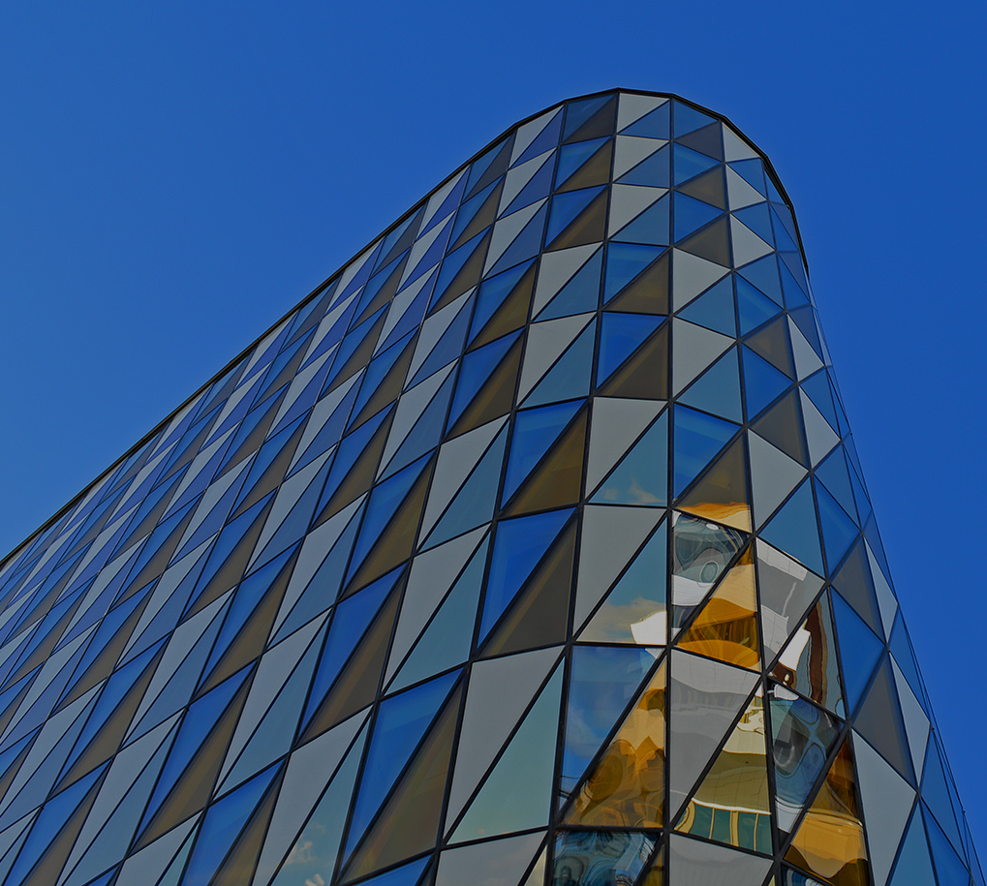
AGENDA
Problem Statements
Project Overview
End Users
Tools And Technologies
Portfolio Design and Layout
Features and Functionality
Results and Screenshots
conclusion
Github Link

Slide 4
PROBLEM STATEMENT
• In the current digital landscape, traditional resumes have limitations in showcasing skills and projects.
• Many individuals, including students and professionals, struggle to effectively highlight their work and achievements online.
• A digital portfolio offers a dynamic and easily accessible way to present one’s skills, experiences, and accomplishments, making it easier for others to discover and appreciate their work.

Slide 5
PROJECT OVERVIEW
• Simplified Explanation of my project.
• Things my portfolio contains
→ About Me
→ Projects
→ Skills
→ Contact
• Main plan: Showing my own achievements , Skills and projects.

Slide 6
WHO ARE THE END USERS ?
1. Students: Showcase academic projects, skills, and experiences to potential employers or academic institutions.
2. Job Seekers: Share digital portfolios with recruiters to demonstrate qualifications and increase job prospects.
3. Freelancers: Display work samples and expertise to attract clients and showcase services. 4. Professionals: Highlight achievements, skills, and experiences to advance careers, network, or pursue new opportunities.

Slide 7
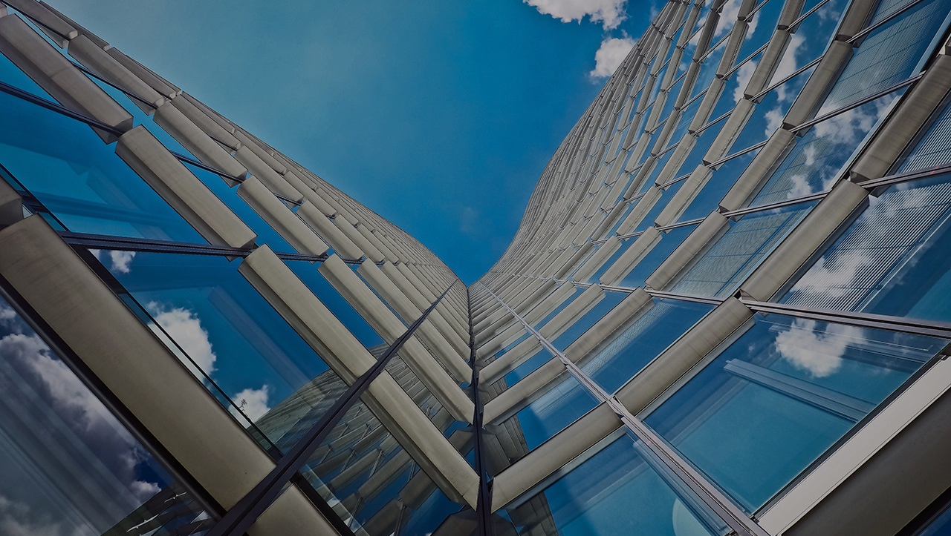
TOOLS AND TECHNIQUES
HTML → For Structure (pages, sections).
CSS → For Styling (colors, layouts, responsiveness).
JavaScript → For Interactivity (navigation menu, animations, form validation).
CODEPEN → For Code Editing
And for hosting we use (GitHub Pages).

Slide 8
POTFOLIO DESIGN AND LAYOUT
Sections included:-
• Home / About Me
• My Projects
• Skills I developed
• Contact details
• Responsive layout in mobile and desktop view

Slide 9

FEATURES AND FUNCTIONALITY
• Navigation: Smooth scrolling • Projects: Visual showcase • Interactions: Engaging animations and effects • Contact: Validated form • Design: Responsive and adaptable

Slide 10
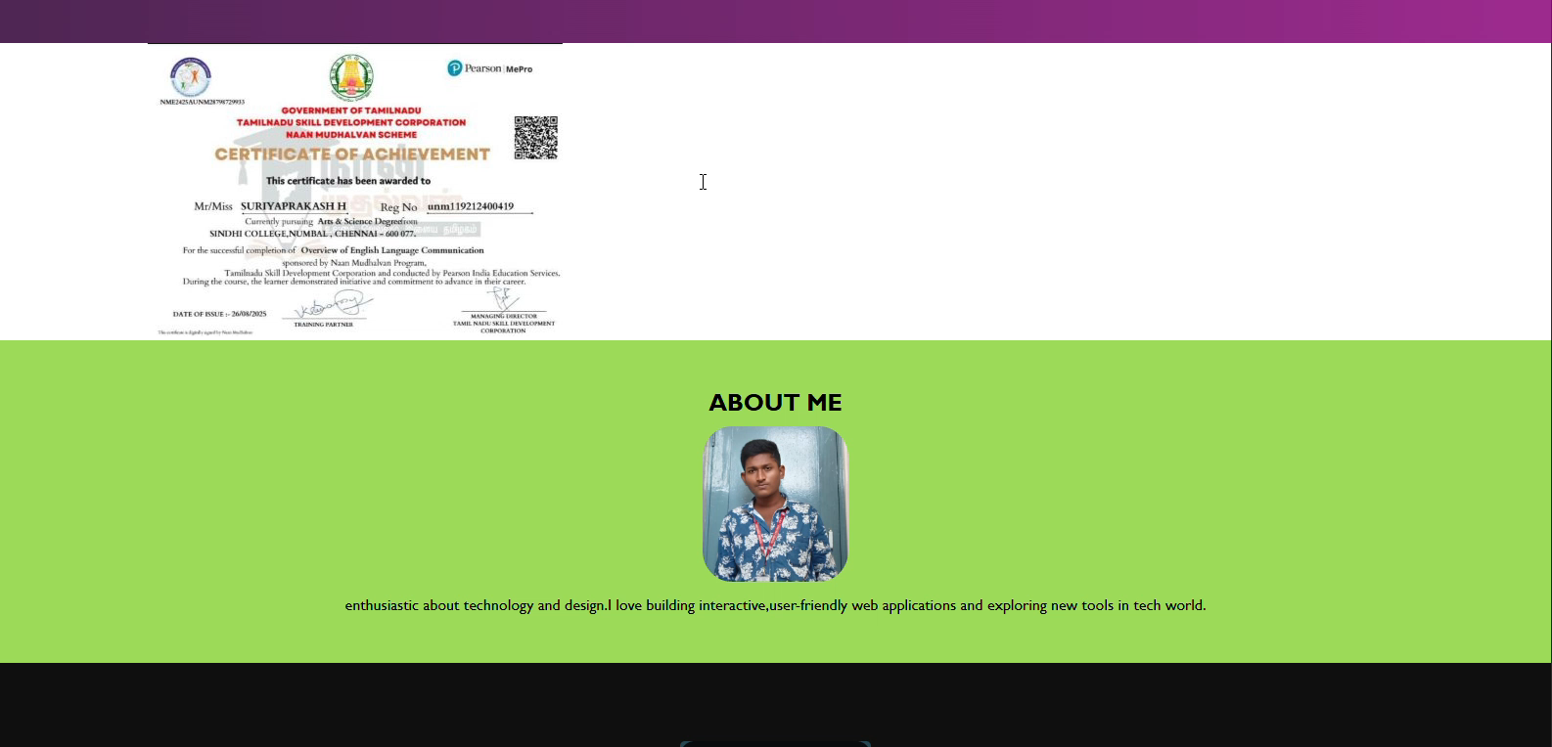
RESULTS AND SCREENSHOTS
Creative Coder
About me
I am a creative developer with a passion for modern web technologies.
Projects

Slide 11
CONCLUSION
Main Achievements: Key features and accomplishments. Project Overview: Summary of the project’s key aspects. Societal Benefits: Positive impact and effects on society.

